Slide 1

Turn The Corner
In Autism Therapy

Slide 2

Current practice in Autism Therapy…
Is good, but we can help it work better…

Slide 3

ABA Therapy is Awesome, but can we help at the root cause level?

Slide 4

Who Need To Use
Human Elements FocusRight?
Caring parents and therapists who value minimizing pharmaceutical approaches and maximizing children’s health..

Slide 5
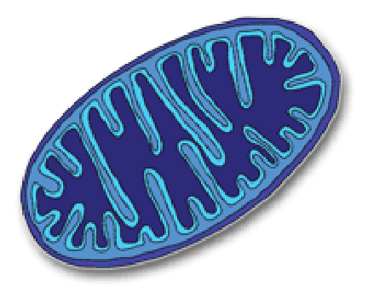
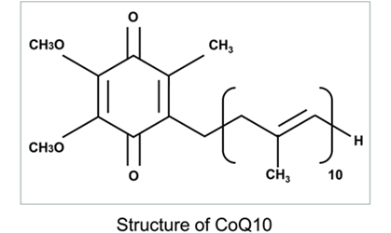
The central player in Human Elements FocusRight:
CoQ10
“greasy” -
Likes to be in membranes
like mitochondria (the power
plants of the cell)

Slide 6
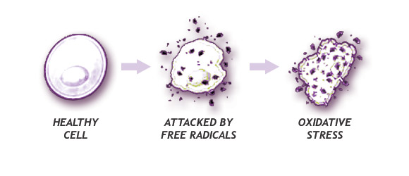

How does CoQ10 work?
CoQ10 is a potent antioxidant – it eliminates free radicals.

Slide 7
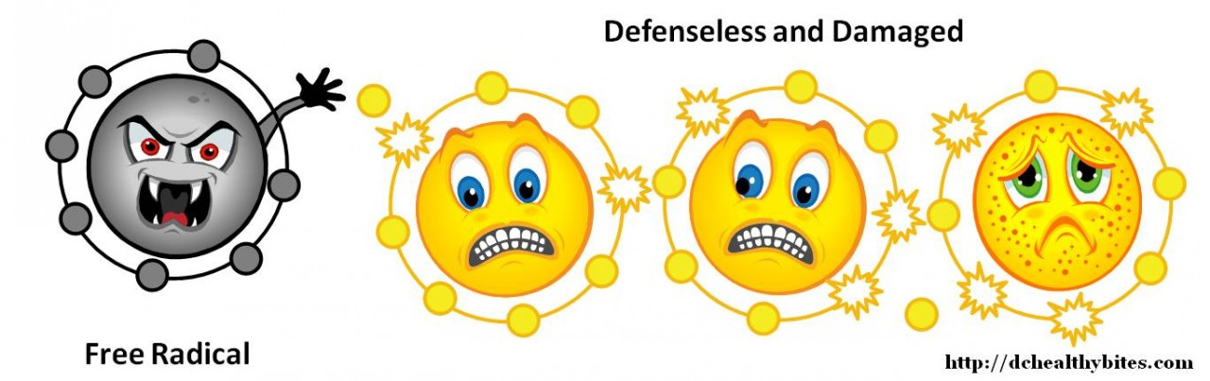
What is a free radical?
An unbalanced molecule that can only be satisfied
by attacking another molecule to damage the healthy molecule.

Slide 8
High levels of oxidative stress are correlated with Children on The Spectrum
McGinnis (Alternative Therapies Nov/Dec 2004, Vol. 10 No. 6, p.22) reviewed many studies that demonstrated increased oxidative damage in children diagnosed with ASD.
Ghezzo et al (PLOS One, June 2013, Vol. 8, No. 6, e66418) found many oxidative stress markers were elevated in children diagnosed with ASD and showed a high correlation with clinical features.

Slide 9
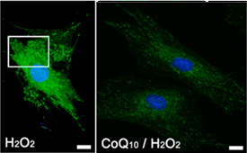
CoQ10 in Cells
CoQ₁₀ reduced oxidative stress in ONH astrocytes (the cells that help nerve cells work optimally).
Astrocytes under oxidative stress (H₂O₂) are rescued with 50 μg/ml CoQ10.
-The intensity of the green indicates the amount of oxidative damage, note the reduction (by approximately 50%) with CoQ10.
From:
Cell Death and Disease (2013) 4, e820
Published online 3 October 2013
Inhibition of oxidative stress by coenzyme Q10 increases mitochondrial mass and improves bioenergetic function in optic nerve head astrocytes
Y H Noh, K-Y Kim, M S Shim, S-H Choi, S Choi, M H Ellisman, R N Weinreb, G A Perkins and W-K Ju

Slide 10
What CoQ10 Does
-works to reduce the effects of maladies caused by free radicals
What maladies are caused by or made worse
by free radicals?
AUTISM Diabetes
Muscle fatigue Heart disease
Joint damage Arthritis
Anhydrosis Weak nails/hair
Immune deficiencies General aging
High blood pressure Gum disease
High cholesterol Decreased athleticism

Slide 11
CoQ10 works with the other
components of Human Elements FocusRight for even
more cellular protection.
CoQ10: Helps Prevent
Joint damage
Muscle fatigue
Anhydrosis
Heart Disease
High Blood Pressure
High Cholesterol
Diabetes
Gum Disease
Immune Deficiencies
CoQ10: The Advantages
Decreases lactate Build-up
Increases Athleticism
Increases Energy
Improves Skin/Nails/Hair
Augments Quality of Life

Slide 12
What are the other
components of Human Elements FocusRight that work with CoQ10 for greater antioxidant effect?
N-Acetyl-Cysteine (NAC): Orally available Amino Acid that is essential to making glutathione – the major cellular radical protectant. (i.e., prevents cell damage due to exercise, pollutants, etc.)
Lipoic Acid (LA): Synergistic with the NAC on glutathione action. Has been shown to reduce inflammation. Lessens the need for NSAIDS like ibuprofen.
Vitamins C,E and selenium: Synergistic with CoQ10 and LA and glutathione action.

Slide 13

Some Other Basic Health Benefits
Multivitamin base + minerals = general well being
Beta-carotene = creates Vitamin A as body needs it
with no toxic side-effects
(vitamin A alone can promote bone fractures)

Slide 14
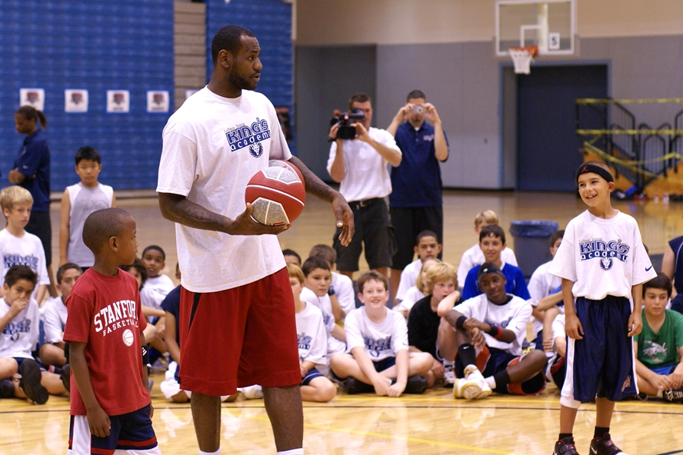
CoQ10 Alone Is Like One Star With Weak Teammates…

Slide 15
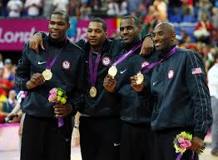
Versus A Team Of Stars

Slide 16
Without Human Elements FocusRight
Membrane Damage
LA
Q
E
C
GSH
LA
NAC
Internal Damage

Slide 17
With Human Elements Focus Right
Healthy Cell
LA
Q
E
C
GSH
LA
NAC

